Slide 1
"Insurance Premium Prediction"
Project Report on,
Dhananjay Krushnat Gurav

Slide 2
Objective:
The goal of this project is to give an estimate of how much they need to spend on their health/medical expenses based on the individual's health condition. And Build a solution that should be able to predict the premium of health insurance for the person.
Benefits :
Gets idea about how much amount required annually according to their own of health status.
This can help a person in focusing more on the health aspect of an insurance
Help in giving idea about cost of premium for health insurance

Slide 3
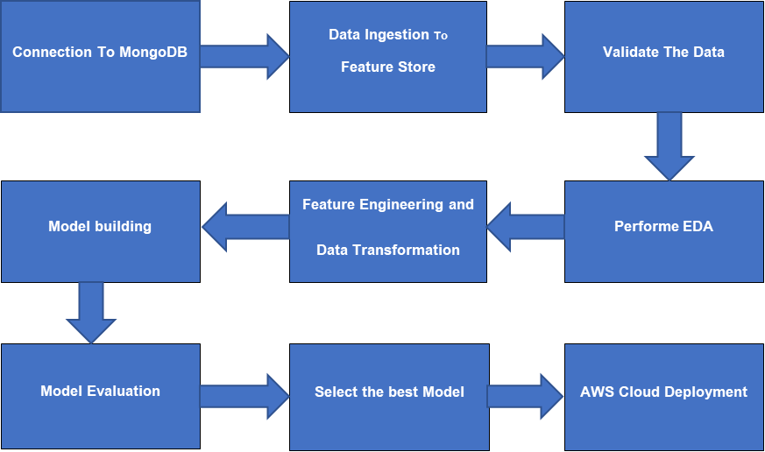
Architecture:

Slide 4
Data Collection and validation:
The dataset was taken from the Kaggle competition page.
Data type of columns – Validated the data type of the columns if wrong, then it was raised error
Null values in columns – Validated whether the column in the dataset has null values or some missing information.

Slide 5
Data Pre-processing & Model Training:
Performed EDA to get insights of the data like identifying distribution, outliers, relation with target variable etc.
Encode the categorical features/columns.
Perform Standard Scalar to scale down values.
Trained different Machine Learning Models on transformed data.

Slide 6
Model Selection :
After data pre-processing and model training, we find the best regression model for premium prediction.
We Selected best model based on accuracy of predictions using evaluation metrics like r2_score (R-squared) and RMSE (Root mean squared error).
XGB Regressor is best model for prediction of premium

Slide 7
Model Deployment:
After Selecting best model, we created API application for hosting it on cloud platform by using which users can make predictions
Saved Model is deployed on cloud using github actions for CICD pipeline and AWS EC2 machine to run model
Also Artifacts derived from training pipeline procedure are stored in amazon S3 bucket

Slide 8
Q & A:
Q1) What is the source data?
Ans: The source of the data is Kaggle. The data is in the form of ‘csv’ file.
Q2) What was the type of the data?
Ans: The data was combination of categorical and numerical values.
Q3) What’s the complete flow you followed in this project?
Ans: Refer the 3rd slide for better understanding
Q4) What techniques were you using for data pre-processing?
Ans: I) Visualizing relation of independent variables with each other and dependent variable.
II) Checking distribution of Continuous variables as well as checking for null values in the dataset. After that applied robust scaler on numerical data and OHE on categorical data.

Slide 9
Q5) How training was done or what models were used?
Ans: Before training the model the dataset is divided into training set and testing/validation set. The scaling was performed on training and validation set. The categorical columns were converted into numeric values. Algorithms like Linear Regression, Decision Trees, Random Forest, and Extreme Gradient Boosting were used for model training and based on RMSE & r2_score the Extreme Gradient boosting model is saved for Validation.
Q6) How prediction was done?
Ans: On the basis of trained model, the prediction was performed. We also created API interface for estimating cost of premium on the basis of personal health information/status.
Q7) What are the different stages of deployment?
Ans: First stage was to integrate whole source code then second one is related to create and push docker image to ECR repository. In the last stage we pulled image from ECR and deploy it on AWS EC2 platform.

Slide 10
Thank You
Dhananjay K. Gurav
dkgurav0101@gmail.com

